Slide 1
The Image of Portugal in Selected Works by Voltaire
David A. Ross, Ph.D. Symposium on Portuguese Traditions
Emeritus Professor of French. UCLA, April 2010
California State University, Fresno
PPT assistance by Ms. Anne-Marie Ross
April 17, 2010

Slide 2
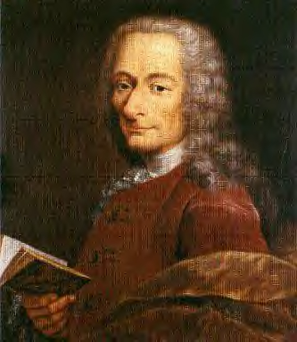
VOLTAIRE
1694-1778
Notes:
beating

Slide 3
Écrasez l’infâme: Destroy Church Abuses
Source of untold suffering and injustice:
• Religious intolerance
• Fanaticism
• Persecution
• Torture
• Execution of “heretics”

Slide 4
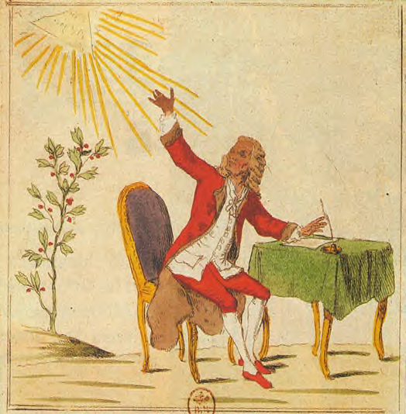
Enlightenment:
reason, humanism,
tolerance, deism,
natural religion .
Heritage:
movement toward a more progressive, moderate, modern, secular politics, society, and religion.
Notes:
Enlightenment resonates in our world

Slide 5
What Impression of Portugal Did Contemporary Readers Derive from Reading These Works by Voltaire?
Title | Genre | Date | “Portugal” mentioned
Le Siècle de Louis XIV | History | 1751 | 44 times
L’Essai sur les moeurs et l’esprit des nations | History | 1756 | 96 times
Le Désastre de Lisbonne | Poem | 1756 | 1 time
Candide ou, l’optimisme | Novel | 1759 | 11 times
Le Précis du siècle de Louis XV | History | 1768 | 23 times

Slide 6
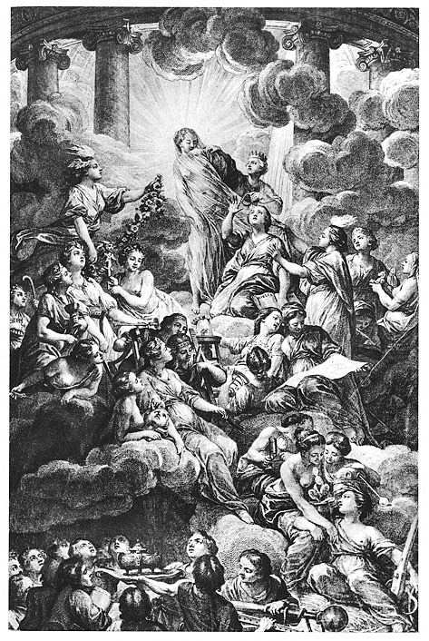
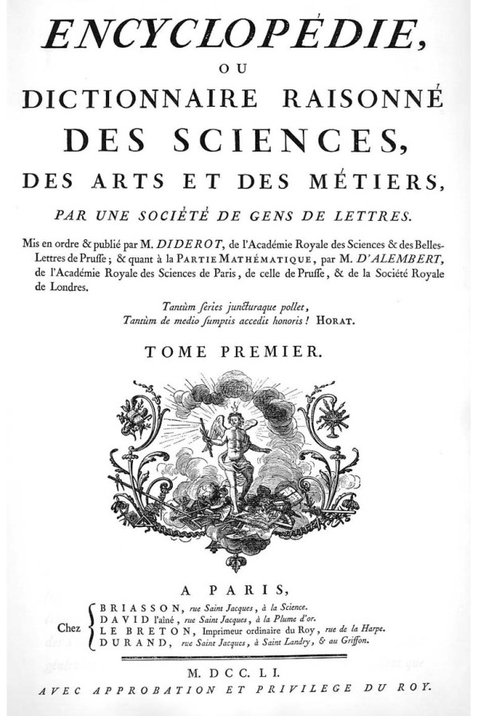
Paris: 1751-1780, 35 vols, in-folio.

Slide 7
HIGHLIGHTS = Image of Portugal in Voltaire’s Works
The Great Discoveries of the 15th & 16th Centuries.
John V, King of Portugal.
The Inquisition in Portugal.
The Lisbon Earthquake.
Pombal’s Cruelty.
A Country Under the Control of England.
What is lacking in this “picture?”

Slide 8
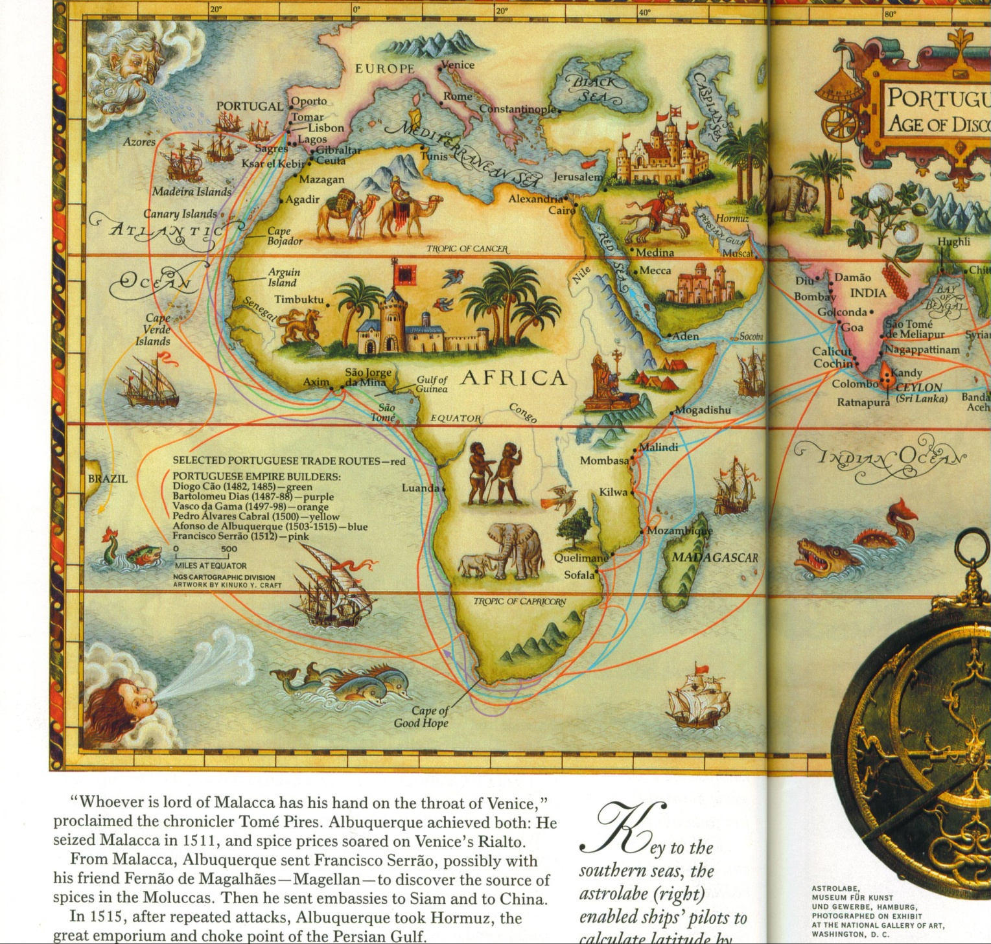
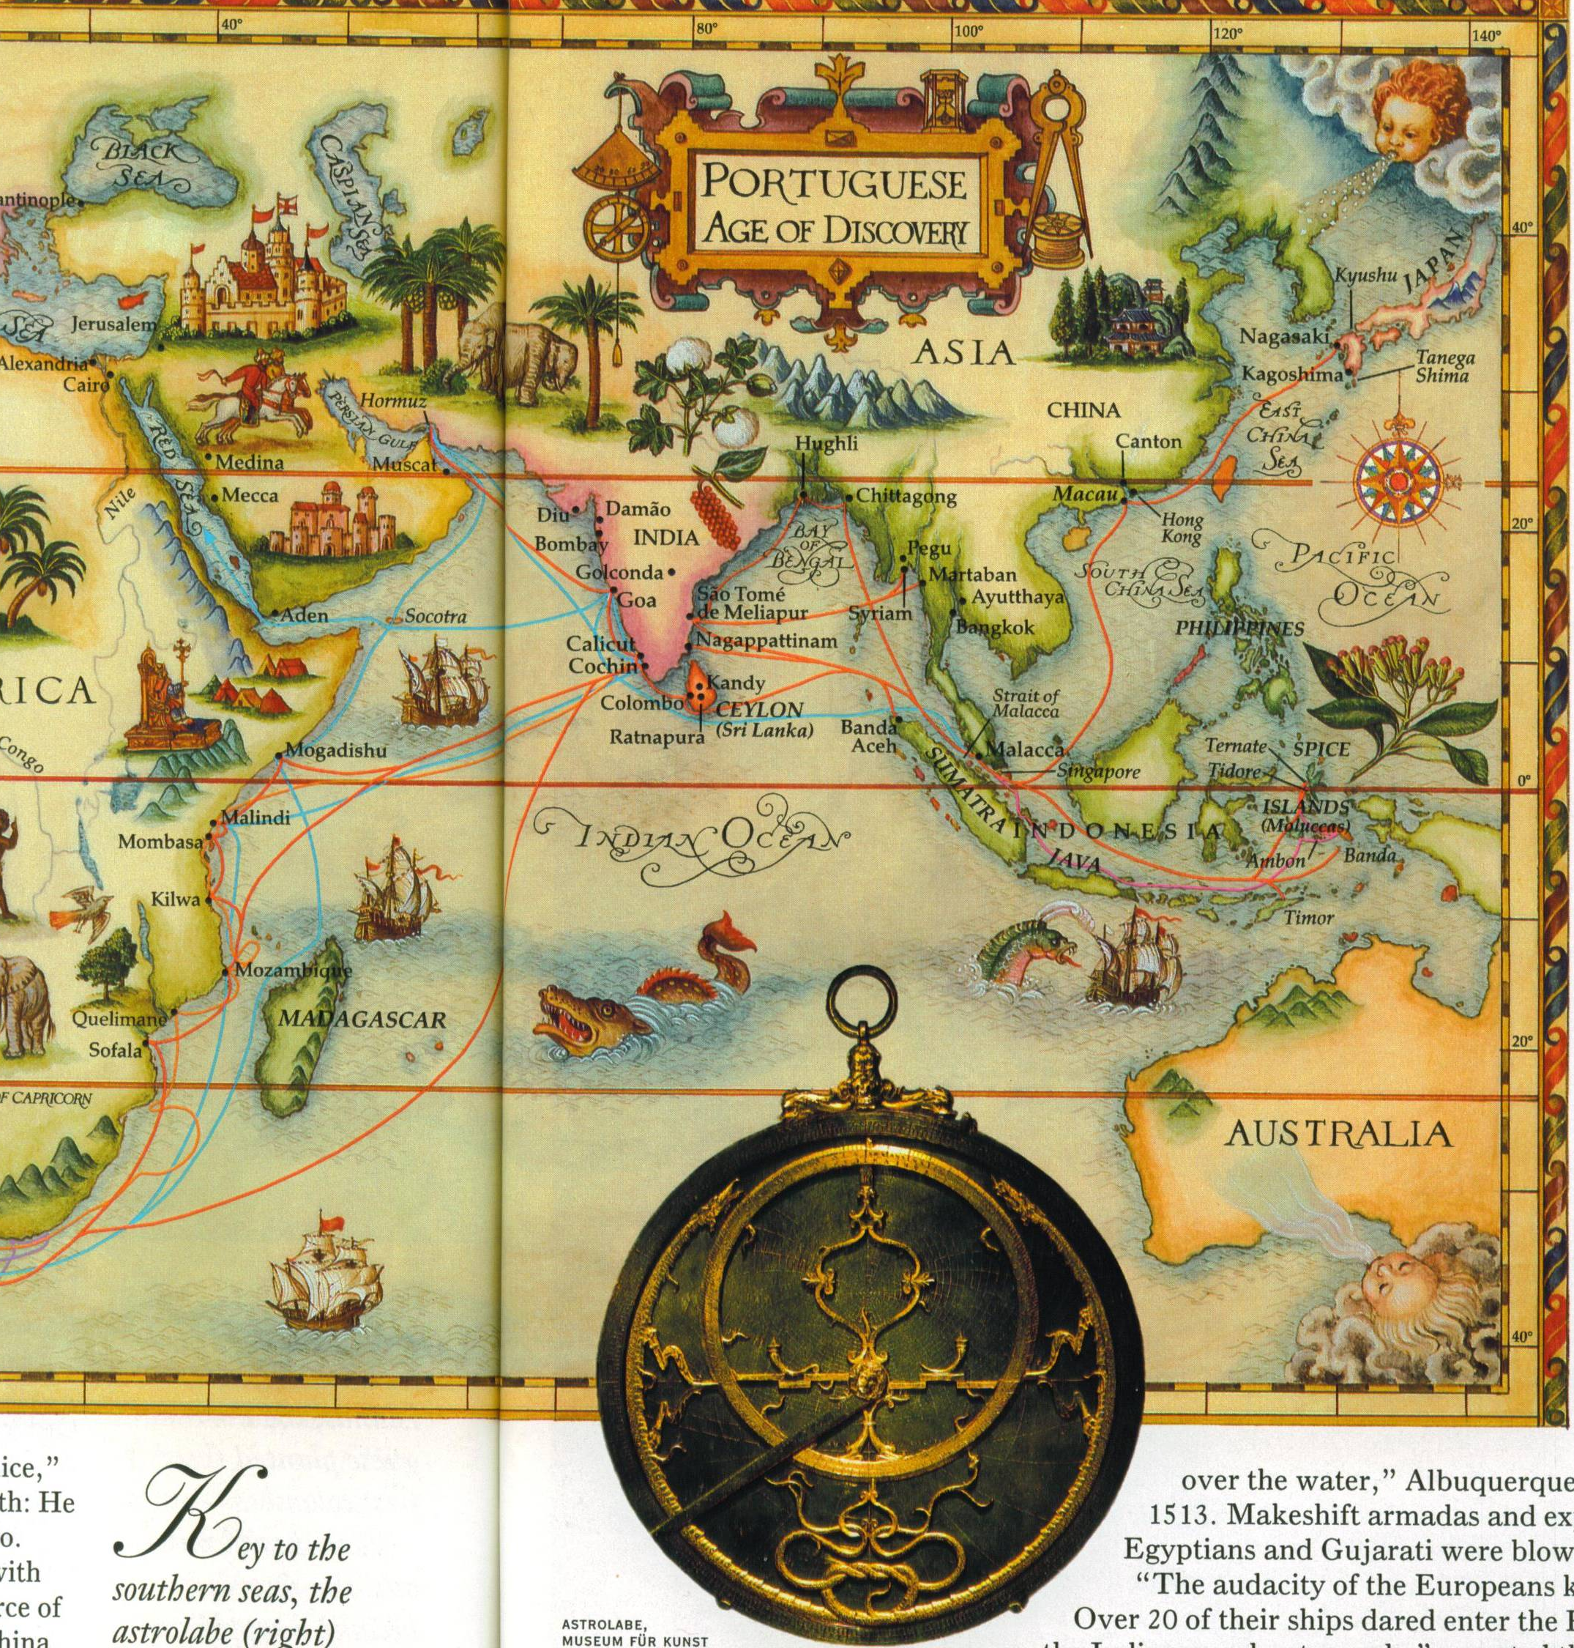

Slide 9
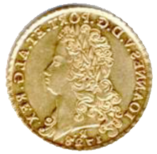
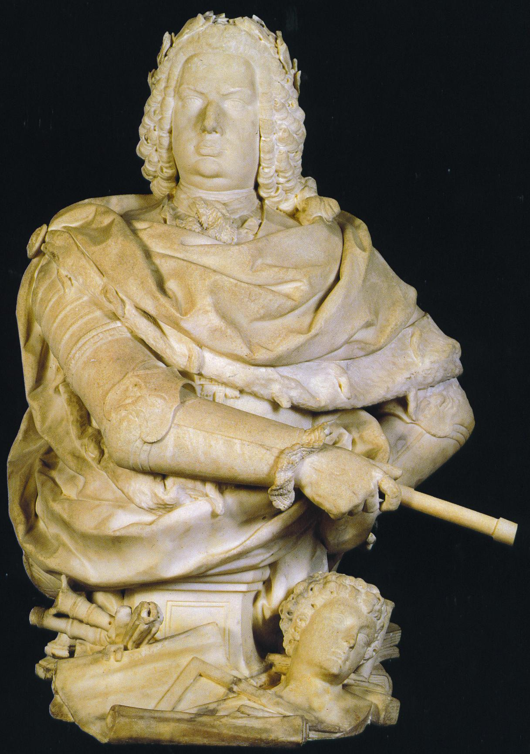
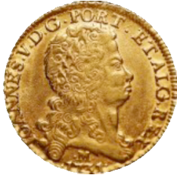
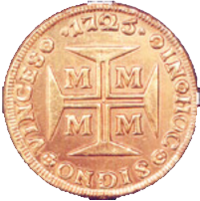
John V,
King of Portugal
1706-1750
Notes:
Gold and riches

Slide 10
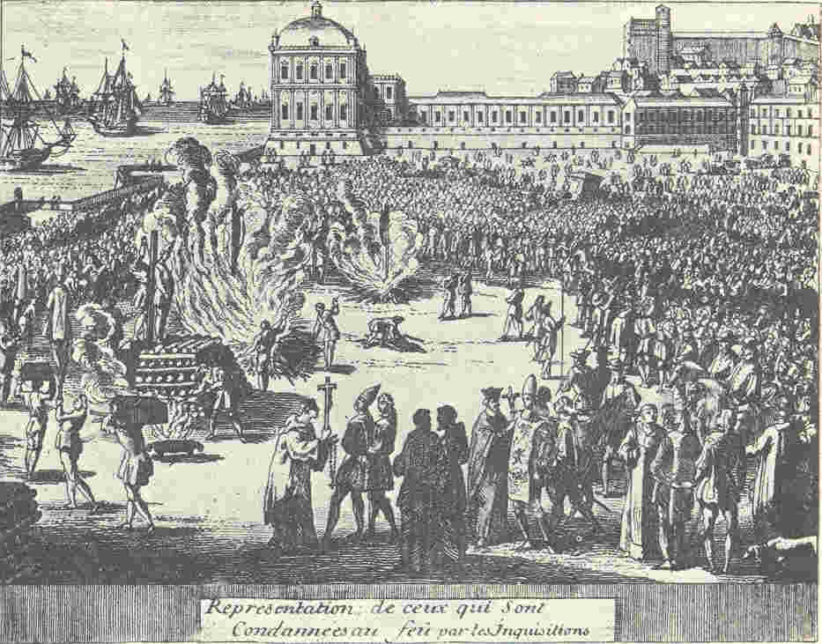
An auto-da fé prior to 1755, Terreiro do Paço
Royal Palace Built by Philip II of Spain during the “Babylonian Captivity,” 1580-1640
Notes:
Pangloss’ reply

Slide 11
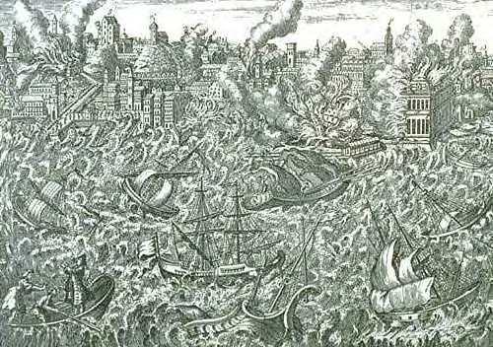
Lisbon 8.6* Earthquake, tsunami, and fire
* Per UC Berkeley’s Earthquake Engineering Research Center
Notes:
Natural disaster

Slide 12
2007

Slide 13
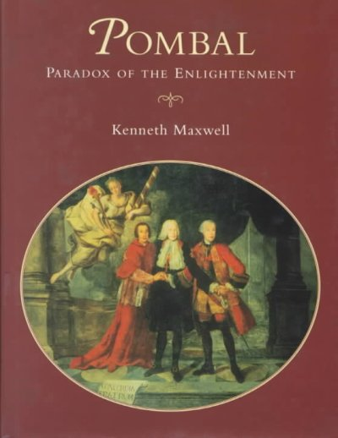
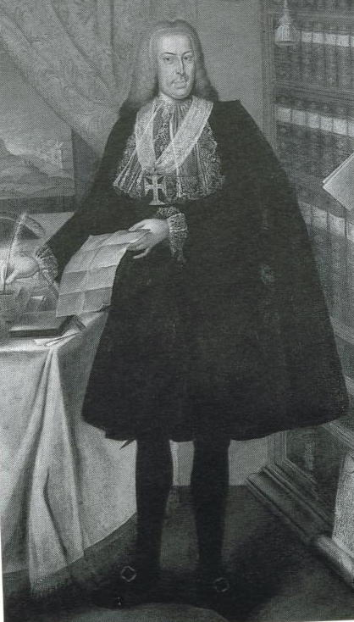
1995

Slide 14
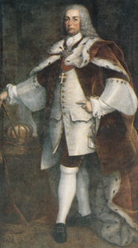
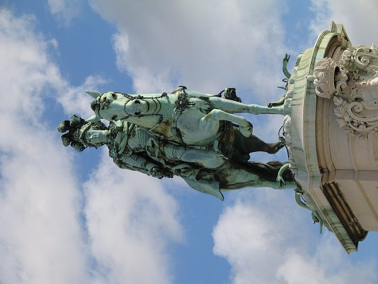
Joseph I
King of Portugal
1750-1777

Slide 15
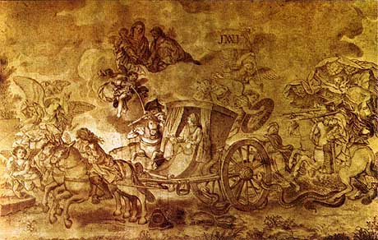
Alleged Assassination Attempt, Joseph I
(September 3, 1758)

Slide 16
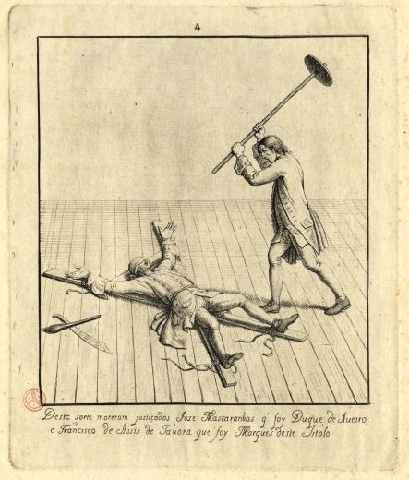
Executions:
The Duke of
Aveiro,
and the
Marquis de Távora

Slide 17
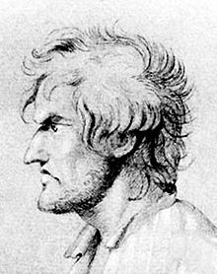
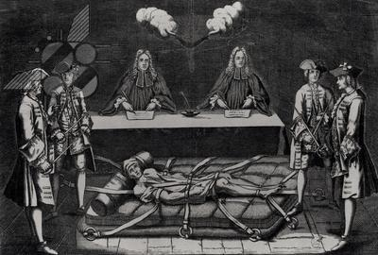
Jean-François Damiens’ Judges

Slide 18
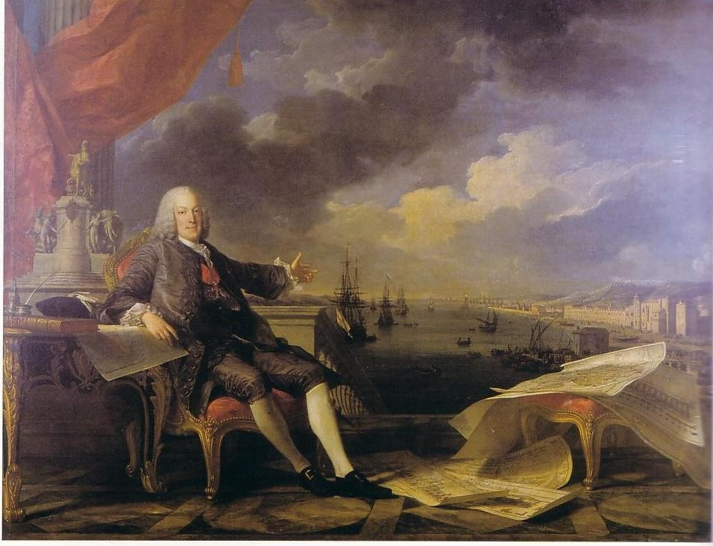
O Marquês de Pombal

Slide 19
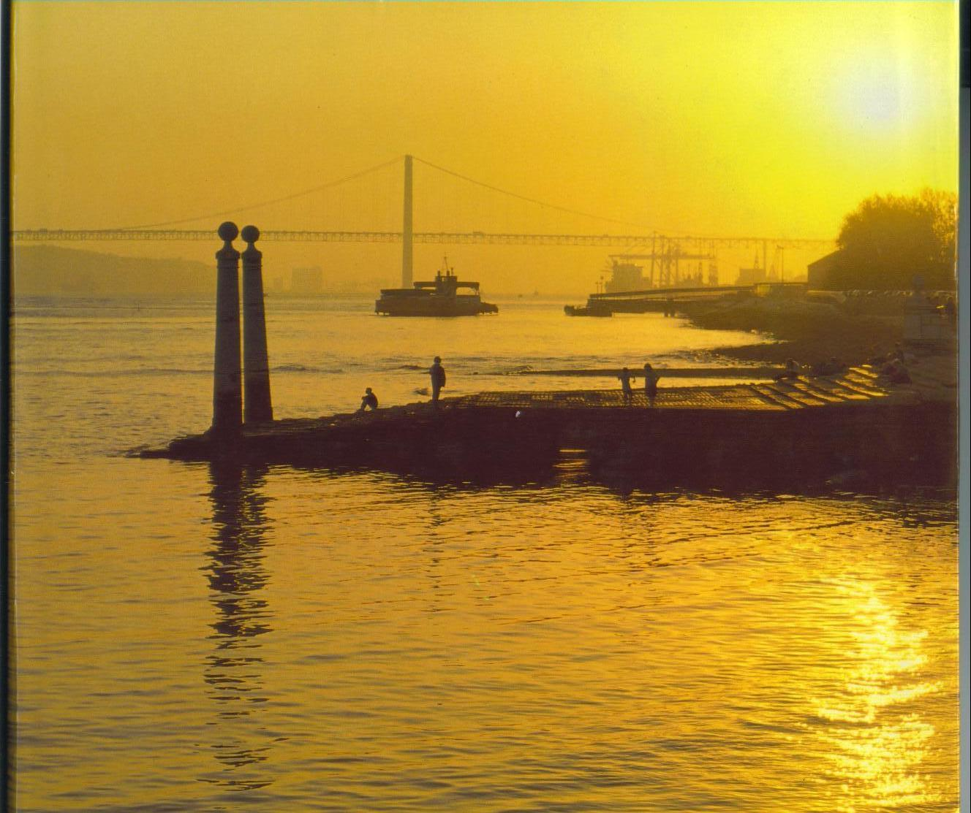

Slide 20
F I M
David A. Ross, Ph.D.
Emeritus Professor of French.
California State University, Fresno
http://zimmer.csufresno.edu/~davidro
PPT assistance by Ms. Anne-Marie Ross

